Slide 1
Introduction to Fuzzy Logic Control
Andrew L. Nelson
Visiting Research Faculty
University of South Florida

Slide 2
Overview
References
Introduction
Crisp Variables
Fuzzy Sets
Linguistic Variables
Membership Functions
Fuzzy Logic
  Fuzzy OR
  Fuzzy AND
  Example
Fuzzy Control
  Variables
  Rules
  Fuzzification
  Defuzzification
Summary
Outline to the left in green
Current topic in yellow
References
Introduction
Crisp Variables
Fuzzy Variables
Fuzzy Logic Operators
Fuzzy Control
Case Study
2/9/2004
Fuzzy Logic

Slide 3
References
References
Introduction
Crisp Variables
Fuzzy Sets
Linguistic Variables
Membership Functions
Fuzzy Logic
  Fuzzy OR
  Fuzzy AND
  Example
Fuzzy Control
  Variables
  Rules
  Fuzzification
  Defuzzification
Summary
L. Zadah, “Fuzzy sets as a basis of possibility” Fuzzy Sets Systems, Vol. 1, pp3-28, 1978.
T. J. Ross, “Fuzzy Logic with Engineering Applications”, McGraw-Hill, 1995.
K. M. Passino, S. Yurkovich, "Fuzzy Control" Addison Wesley, 1998.
2/9/2004
Fuzzy Logic

Slide 4
Introduction
References
Introduction
Crisp Variables
Fuzzy Sets
Linguistic Variables
Membership Functions
Fuzzy Logic
  Fuzzy OR
  Fuzzy AND
  Example
Fuzzy Control
  Variables
  Rules
  Fuzzification
  Defuzzification
Summary
Fuzzy logic:
  A way to represent variation or imprecision in logic
  A way to make use of natural language in logic
  Approximate reasoning
Humans say things like "If it is sunny and warm today, I will drive fast"
Linguistic variables:
  Temp: {freezing, cool, warm, hot}
  Cloud Cover: {overcast, partly cloudy, sunny}
  Speed: {slow, fast}
2/9/2004
Fuzzy Logic

Slide 5
Crisp (Traditional) Variables
Crisp variables represent precise quantities:
  x = 3.1415296
  A ∈{0,1}
A proposition is either True or False
  A ∧ B ⇒ C
King(Richard) ∧ Greedy(Richard) ⇒ Evil(Richard)
Richard is either greedy or he isn't:
  Greedy(Richard) ∈{0,1}
References
Introduction
Crisp Variables
Fuzzy Sets
Linguistic Variables
Membership Functions
Fuzzy Logic
  Fuzzy OR
  Fuzzy AND
  Example
Fuzzy Control
  Variables
  Rules
  Fuzzification
  Defuzzification
Summary
2/9/2004
Fuzzy Logic

Slide 6
Fuzzy Sets
References
Introduction
Crisp Variables
Fuzzy Sets
Linguistic Variables
Membership Functions
Fuzzy Logic
  Fuzzy OR
  Fuzzy AND
  Example
Fuzzy Control
  Variables
  Rules
  Fuzzification
  Defuzzification
Summary
What if Richard is only somewhat greedy?
Fuzzy Sets can represent the degree to which a quality is possessed.
Fuzzy Sets (Simple Fuzzy Variables) have values in the range of [0,1]
Greedy(Richard) = 0.7
Question: How evil is Richard?
2/9/2004
Fuzzy Logic

Slide 7
Fuzzy Linguistic Variables
References
Introduction
Crisp Variables
Fuzzy Sets
Linguistic Variables
Membership Functions
Fuzzy Logic
  Fuzzy OR
  Fuzzy AND
  Example
Fuzzy Control
  Variables
  Rules
  Fuzzification
  Defuzzification
Summary
Fuzzy Linguistic Variables are used to represent qualities spanning a particular spectrum
Temp: {Freezing, Cool, Warm, Hot}
Membership Function
Question: What is the temperature?
Answer: It is warm.
Question: How warm is it?
2/9/2004
Fuzzy Logic

Slide 8
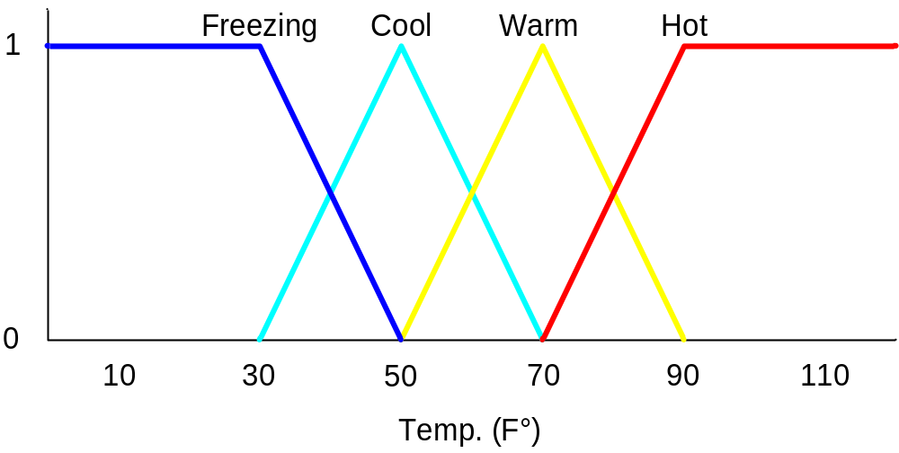
Membership Functions
References
Introduction
Crisp Variables
Fuzzy Sets
Linguistic Variables
Membership Functions
Fuzzy Logic
  Fuzzy OR
  Fuzzy AND
  Example
Fuzzy Control
  Variables
  Rules
  Fuzzification
  Defuzzification
Summary
Temp: {Freezing, Cool, Warm, Hot}
Degree of Truth or "Membership"
2/9/2004
Fuzzy Logic

Slide 9
Membership Functions
References
Introduction
Crisp Variables
Fuzzy Sets
Linguistic Variables
Membership Functions
Fuzzy Logic
  Fuzzy OR
  Fuzzy AND
  Example
Fuzzy Control
  Variables
  Rules
  Fuzzification
  Defuzzification
Summary
How cool is 36 F° ?
2/9/2004
Fuzzy Logic

Slide 10
Membership Functions
References
Introduction
Crisp Variables
Fuzzy Sets
Linguistic Variables
Membership Functions
Fuzzy Logic
  Fuzzy OR
  Fuzzy AND
  Example
Fuzzy Control
  Variables
  Rules
  Fuzzification
  Defuzzification
Summary
How cool is 36 F° ?
It is 30% Cool and 70% Freezing
0.7
0.3
2/9/2004
Fuzzy Logic

Slide 11
Fuzzy Logic
References
Introduction
Crisp Variables
Fuzzy Sets
Linguistic Variables
Membership Functions
Fuzzy Logic
  Fuzzy OR
  Fuzzy AND
  Example
Fuzzy Control
  Variables
  Rules
  Fuzzification
  Defuzzification
Summary
How do we use fuzzy membership functions in predicate logic?
Fuzzy logic Connectives:
  Fuzzy Conjunction, ∧
  Fuzzy Disjunction, ∨
Operate on degrees of membership in fuzzy sets
2/9/2004
Fuzzy Logic

Slide 12

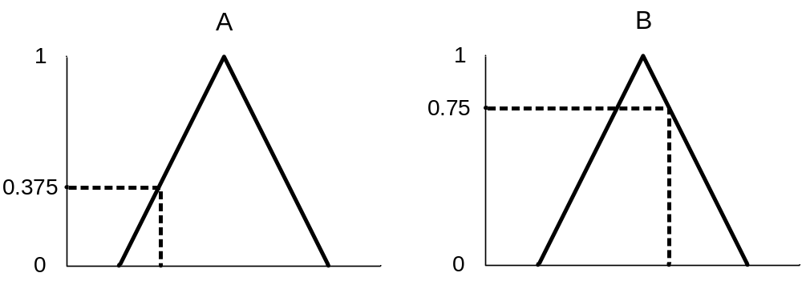
Fuzzy Disjunction
References
Introduction
Crisp Variables
Fuzzy Sets
Linguistic Variables
Membership Functions
Fuzzy Logic
  Fuzzy OR
  Fuzzy AND
  Example
Fuzzy Control
  Variables
  Rules
  Fuzzification
  Defuzzification
Summary
A∨B max(A, B)
A∨B = C "Quality C is the disjunction of Quality A and B"
(A∨B = C) ⇒ (C = 0.75)
2/9/2004
Fuzzy Logic

Slide 13
Fuzzy Conjunction
References
Introduction
Crisp Variables
Fuzzy Sets
Linguistic Variables
Membership Functions
Fuzzy Logic
  Fuzzy OR
  Fuzzy AND
  Example
Fuzzy Control
  Variables
  Rules
  Fuzzification
  Defuzzification
Summary
A∧B min(A, B)
A∧B = C "Quality C is the conjunction of Quality A and B"
(A∧B = C) ⇒ (C = 0.375)
2/9/2004
Fuzzy Logic

Slide 14
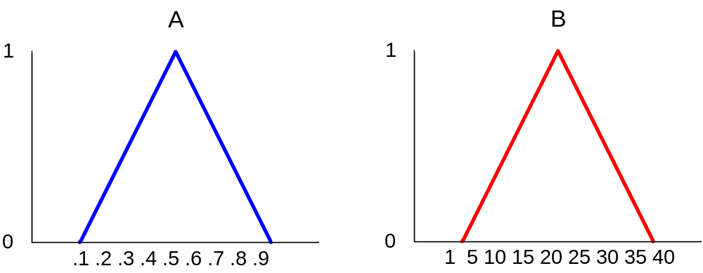
Example: Fuzzy Conjunction
Calculate A∧B given that A is .4 and B is 20
References
Introduction
Crisp Variables
Fuzzy Sets
Linguistic Variables
Membership Functions
Fuzzy Logic
  Fuzzy OR
  Fuzzy AND
  Example
Fuzzy Control
  Variables
  Rules
  Fuzzification
  Defuzzification
Summary
2/9/2004
Fuzzy Logic

Slide 15
Example: Fuzzy Conjunction
Calculate A∧B given that A is .4 and B is 20
References
Introduction
Crisp Variables
Fuzzy Sets
Linguistic Variables
Membership Functions
Fuzzy Logic
  Fuzzy OR
  Fuzzy AND
  Example
Fuzzy Control
  Variables
  Rules
  Fuzzification
  Defuzzification
Summary
  Determine degrees of membership:
2/9/2004
Fuzzy Logic

Slide 16
Example: Fuzzy Conjunction
Calculate A∧B given that A is .4 and B is 20
References
Introduction
Crisp Variables
Fuzzy Sets
Linguistic Variables
Membership Functions
Fuzzy Logic
  Fuzzy OR
  Fuzzy AND
  Example
Fuzzy Control
  Variables
  Rules
  Fuzzification
  Defuzzification
Summary
0.7
  Determine degrees of membership:
    A = 0.7
2/9/2004
Fuzzy Logic

Slide 17
Example: Fuzzy Conjunction
Calculate A∧B given that A is .4 and B is 20
References
Introduction
Crisp Variables
Fuzzy Sets
Linguistic Variables
Membership Functions
Fuzzy Logic
  Fuzzy OR
  Fuzzy AND
  Example
Fuzzy Control
  Variables
  Rules
  Fuzzification
  Defuzzification
Summary
0.9
0.7
  Determine degrees of membership:
    A = 0.7 B = 0.9
2/9/2004
Fuzzy Logic

Slide 18
Example: Fuzzy Conjunction
Calculate A∧B given that A is .4 and B is 20
References
Introduction
Crisp Variables
Fuzzy Sets
Linguistic Variables
Membership Functions
Fuzzy Logic
  Fuzzy OR
  Fuzzy AND
  Example
Fuzzy Control
  Variables
  Rules
  Fuzzification
  Defuzzification
Summary
0.9
0.7
  Determine degrees of membership:
    A = 0.7 B = 0.9
  Apply Fuzzy AND
    A∧B = min(A, B) = 0.7
2/9/2004
Fuzzy Logic

Slide 19
Fuzzy Control
References
Introduction
Crisp Variables
Fuzzy Sets
Linguistic Variables
Membership Functions
Fuzzy Logic
  Fuzzy OR
  Fuzzy AND
  Example
Fuzzy Control
  Variables
  Rules
  Fuzzification
  Defuzzification
Summary
Fuzzy Control combines the use of fuzzy linguistic variables with fuzzy logic
Example: Speed Control
How fast am I going to drive today?
It depends on the weather.
Disjunction of Conjunctions
2/9/2004
Fuzzy Logic

Slide 20
Inputs: Temperature
References
Introduction
Crisp Variables
Fuzzy Sets
Linguistic Variables
Membership Functions
Fuzzy Logic
  Fuzzy OR
  Fuzzy AND
  Example
Fuzzy Control
  Variables
  Rules
  Fuzzification
  Defuzzification
Summary
Temp: {Freezing, Cool, Warm, Hot}
2/9/2004
Fuzzy Logic

Slide 21
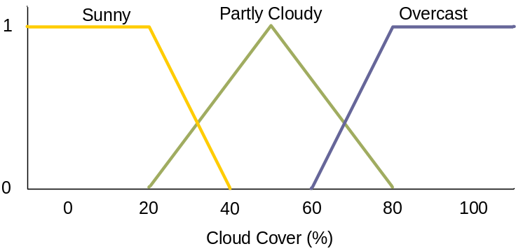
Inputs: Temperature, Cloud Cover
References
Introduction
Crisp Variables
Fuzzy Sets
Linguistic Variables
Membership Functions
Fuzzy Logic
  Fuzzy OR
  Fuzzy AND
  Example
Fuzzy Control
  Variables
  Rules
  Fuzzification
  Defuzzification
Summary
Temp: {Freezing, Cool, Warm, Hot}
Cover: {Sunny, Partly, Overcast}
2/9/2004
Fuzzy Logic

Slide 22
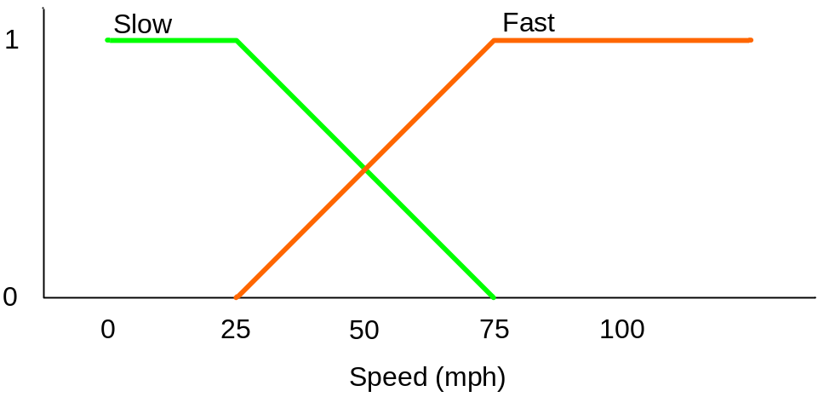
Output: Speed
References
Introduction
Crisp Variables
Fuzzy Sets
Linguistic Variables
Membership Functions
Fuzzy Logic
  Fuzzy OR
  Fuzzy AND
  Example
Fuzzy Control
  Variables
  Rules
  Fuzzification
  Defuzzification
Summary
Speed: {Slow, Fast}
2/9/2004
Fuzzy Logic

Slide 23
Rules
References
Introduction
Crisp Variables
Fuzzy Sets
Linguistic Variables
Membership Functions
Fuzzy Logic
  Fuzzy OR
  Fuzzy AND
  Example
Fuzzy Control
  Variables
  Rules
  Fuzzification
  Defuzzification
Summary
If it's Sunny and Warm, drive Fast
Sunny(Cover)∧Warm(Temp)⇒ Fast(Speed)
If it's Cloudy and Cool, drive Slow
Cloudy(Cover)∧Cool(Temp)⇒ Slow(Speed)
Driving Speed is the combination of output of these rules...
2/9/2004
Fuzzy Logic

Slide 24
Example Speed Calculation
References
Introduction
Crisp Variables
Fuzzy Sets
Linguistic Variables
Membership Functions
Fuzzy Logic
  Fuzzy OR
  Fuzzy AND
  Example
Fuzzy Control
  Variables
  Rules
  Fuzzification
  Defuzzification
Summary
How fast will I go if it is
  65 F°
  25 % Cloud Cover ?
2/9/2004
Fuzzy Logic

Slide 25
Fuzzification:
Calculate Input Membership Levels
References
Introduction
Crisp Variables
Fuzzy Sets
Linguistic Variables
Membership Functions
Fuzzy Logic
  Fuzzy OR
  Fuzzy AND
  Example
Fuzzy Control
  Variables
  Rules
  Fuzzification
  Defuzzification
Summary
65 F° ⇒ Cool = 0.4, Warm= 0.7
2/9/2004
Fuzzy Logic

Slide 26
Fuzzification:
Calculate Input Membership Levels
References
Introduction
Crisp Variables
Fuzzy Sets
Linguistic Variables
Membership Functions
Fuzzy Logic
  Fuzzy OR
  Fuzzy AND
  Example
Fuzzy Control
  Variables
  Rules
  Fuzzification
  Defuzzification
Summary
65 F° ⇒ Cool = 0.4, Warm= 0.7
25% Cover ⇒Sunny = 0.8, Cloudy = 0.2
2/9/2004
Fuzzy Logic

Slide 27
...Calculating...
References
Introduction
Crisp Variables
Fuzzy Sets
Linguistic Variables
Membership Functions
Fuzzy Logic
  Fuzzy OR
  Fuzzy AND
  Example
Fuzzy Control
  Variables
  Rules
  Fuzzification
  Defuzzification
Summary
If it's Sunny and Warm, drive Fast
Sunny(Cover)∧Warm(Temp)⇒Fast(Speed)
0.8 ∧ 0.7 = 0.7
⇒ Fast = 0.7
If it's Cloudy and Cool, drive Slow
Cloudy(Cover)∧Cool(Temp)⇒Slow(Speed)
0.2 ∧ 0.4 = 0.2
⇒ Slow = 0.2
2/9/2004
Fuzzy Logic

Slide 28
Defuzzification:
Constructing the Output
References
Introduction
Crisp Variables
Fuzzy Sets
Linguistic Variables
Membership Functions
Fuzzy Logic
  Fuzzy OR
  Fuzzy AND
  Example
Fuzzy Control
  Variables
  Rules
  Fuzzification
  Defuzzification
Summary
Speed is 20% Slow and 70% Fast
Find centroids: Location where membership is 100%
2/9/2004
Fuzzy Logic

Slide 29
Defuzzification:
Constructing the Output
References
Introduction
Crisp Variables
Fuzzy Sets
Linguistic Variables
Membership Functions
Fuzzy Logic
  Fuzzy OR
  Fuzzy AND
  Example
Fuzzy Control
  Variables
  Rules
  Fuzzification
  Defuzzification
Summary
Speed is 20% Slow and 70% Fast
Find centroids: Location where membership is 100%
2/9/2004
Fuzzy Logic

Slide 30
Defuzzification:
Constructing the Output
References
Introduction
Crisp Variables
Fuzzy Sets
Linguistic Variables
Membership Functions
Fuzzy Logic
  Fuzzy OR
  Fuzzy AND
  Example
Fuzzy Control
  Variables
  Rules
  Fuzzification
  Defuzzification
Summary
Speed is 20% Slow and 70% Fast
Speed = weighted mean
= (2*25+...
2/9/2004
Fuzzy Logic

Slide 31
Defuzzification:
Constructing the Output
References
Introduction
Crisp Variables
Fuzzy Sets
Linguistic Variables
Membership Functions
Fuzzy Logic
  Fuzzy OR
  Fuzzy AND
  Example
Fuzzy Control
  Variables
  Rules
  Fuzzification
  Defuzzification
Summary
Speed is 20% Slow and 70% Fast
Speed = weighted mean
= (2*25+7*75)/(9)
= 63.8 mph
2/9/2004
Fuzzy Logic

Slide 32
Notes: Follow-up Points
References
Introduction
Crisp Variables
Fuzzy Sets
Linguistic Variables
Membership Functions
Fuzzy Logic
  Fuzzy OR
  Fuzzy AND
  Example
Fuzzy Control
  Variables
  Rules
  Fuzzification
  Defuzzification
Summary
Fuzzy Logic Control allows for the smooth interpolation between variable centroids with relatively few rules
This does not work with crisp (traditional Boolean) logic
Provides a natural way to model some types of human expertise in a computer program
2/9/2004
Fuzzy Logic

Slide 33
Notes: Drawbacks to Fuzzy logic
References
Introduction
Crisp Variables
Fuzzy Sets
Linguistic Variables
Membership Functions
Fuzzy Logic
  Fuzzy OR
  Fuzzy AND
  Example
Fuzzy Control
  Variables
  Rules
  Fuzzification
  Defuzzification
Summary
Requires tuning of membership functions
Fuzzy Logic control may not scale well to large or complex problems
Deals with imprecision, and vagueness, but not uncertainty
2/9/2004
Fuzzy Logic

Slide 34
Summary
References
Introduction
Crisp Variables
Fuzzy Sets
Linguistic Variables
Membership Functions
Fuzzy Logic
  Fuzzy OR
  Fuzzy AND
  Example
Fuzzy Control
  Variables
  Rules
  Fuzzification
  Defuzzification
Summary
Fuzzy Logic provides way to calculate with imprecision and vagueness
Fuzzy Logic can be used to represent some kinds of human expertise
Fuzzy Membership Sets
Fuzzy Linguistic Variables
Fuzzy AND and OR
Fuzzy Control
2/9/2004
Fuzzy Logic

Slide 35
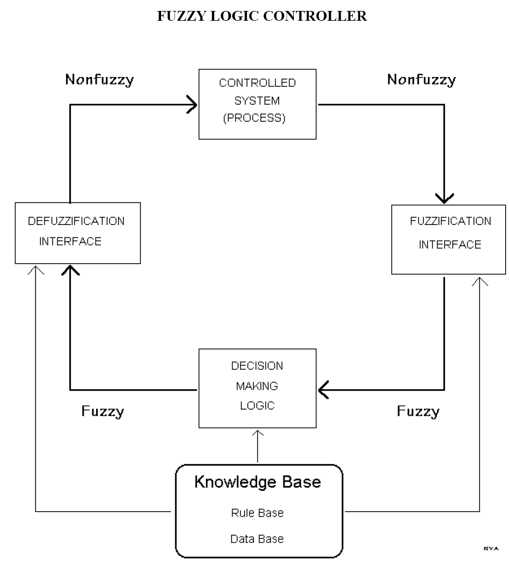
Examples
2/9/2004
Fuzzy Logic

Slide 36
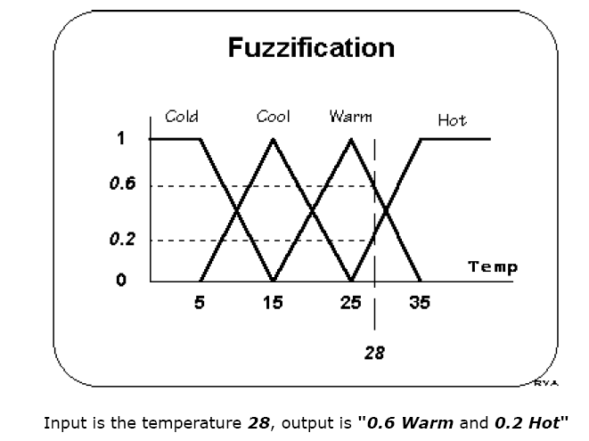
2/9/2004
Fuzzy Logic

Slide 37
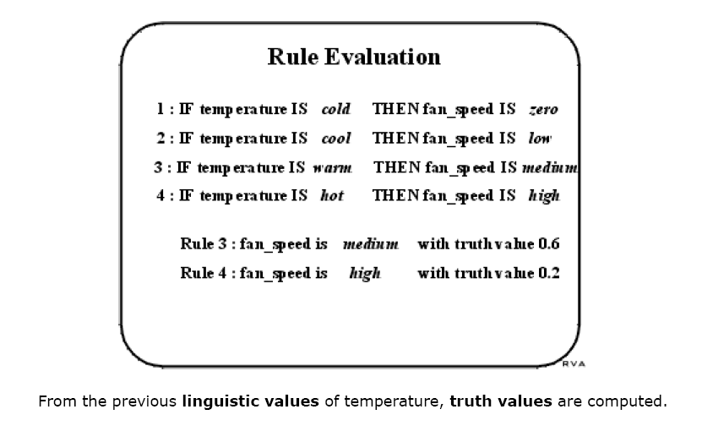
2/9/2004
Fuzzy Logic

Slide 38
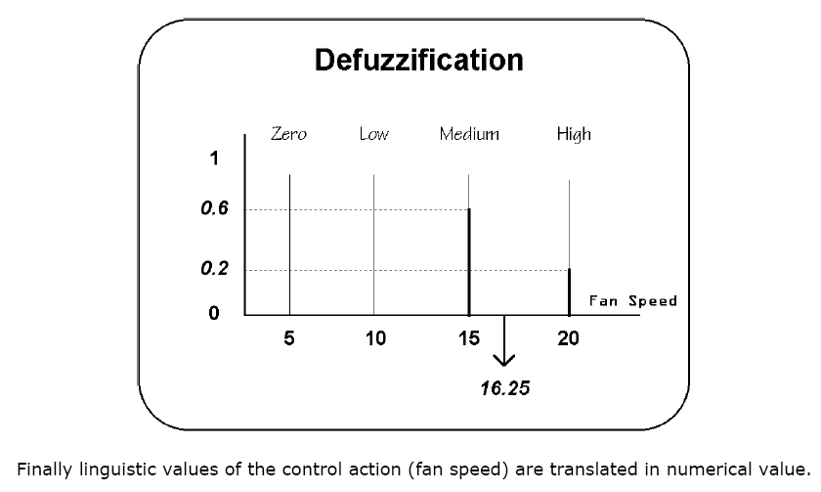
2/9/2004
Fuzzy Logic

Slide 39
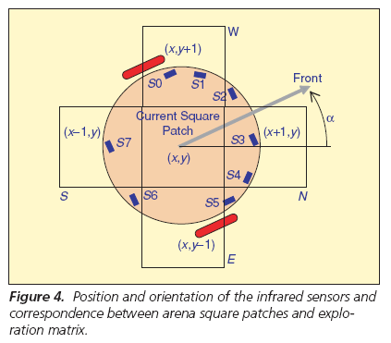
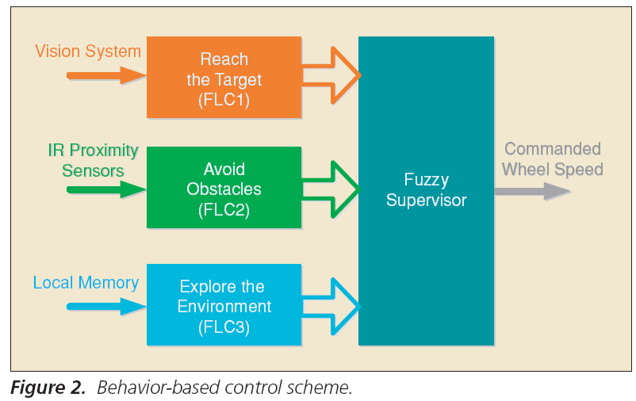
Fuzzy Control For a Mobile Robot
2/9/2004
Fuzzy Logic

Slide 40
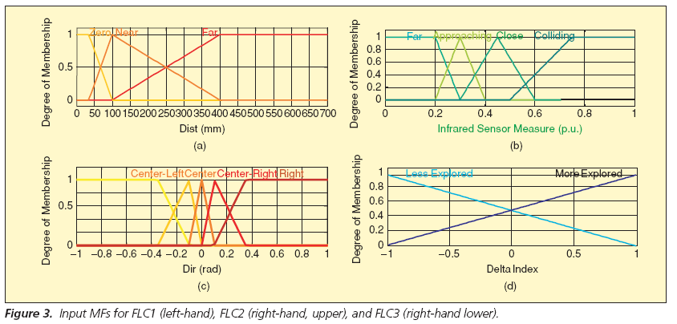
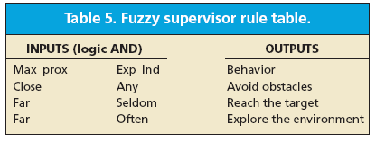
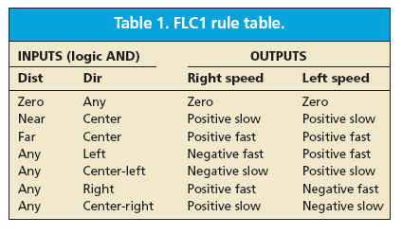
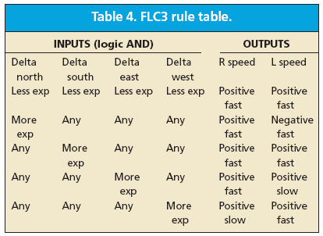
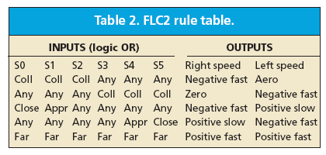
2/9/2004
Fuzzy Logic

